Slide 1

Front End Engineering-II
Project Report Semester-IV (Batch-2022)
Template-25
Supervised By:
Raveesh Samkaria
Submitted By:
Pulkit Vashisht
2210992594
G-14
Department of Computer Science and Engineering Chitkara University Institute of Engineering & Technology,
Chitkara University, Punjab

Slide 2
1.INTRODUCTION This project is a web application built using React and Vite. React is a popular JavaScript library for building user interfaces, while Vite is a modern build tool that provides a faster and leaner development experience for modern web projects. The application comprises five main components, each contributing to a different section of a comprehensive web page.
1.1 BACKGROUND
Web development has evolved significantly over the years, with a growing emphasis on creating highly interactive and responsive user interfaces. Traditional build tools often struggle to keep up with the demands of modern development, leading to slow build times and a suboptimal developer experience. Vite addresses these issues by offering a faster, more efficient build process, leveraging native ES modules in the browser for an optimized development environment. Combining Vite with React's component-based architecture allows developers to build scalable and maintainable web applications more efficiently.
React
React is a popular JavaScript library created by Facebook for building user interfaces. It makes creating dynamic web applications easier by breaking down the UI into small, reusable components. These components can manage their own state and update efficiently when the data changes, thanks to a system called the virtual DOM. React's straightforward approach to building interactive UIs has made it a favorite among developers.
Vite
Vite is a modern build tool designed to improve the development experience. Traditional build tools can be slow, especially as projects grow larger, because they bundle all the code before running the application. Vite solves this by serving the source code directly using native ES modules in the browser during development, which speeds up the process. It also provides features like hot module replacement (HMR), which updates parts of the application instantly as you make changes, without needing a full reload.

Slide 3
1.2 OBJECTIVES
The primary objective of this project is to demonstrate the integration of Vite and React to create a high-performance, user-friendly web application. The application aims to showcase the following:
Modular Component Design: By breaking down the web page into five distinct components (First, Second, Third, Fourth, and Fifthpage), the project highlights the advantages of React's component-based architecture. This modularity enhances maintainability and scalability.
Responsive and Adaptive UI: The project includes responsive design principles, ensuring the application is usable across a wide range of devices and screen sizes. This is achieved through CSS styles that adapt to different color schemes and resolutions.
Efficient Development Workflow: Utilizing Vite as the build tool demonstrates the benefits of faster build times, hot module replacement (HMR), and an overall improved development experience. This leads to quicker iterations and a more productive development process.
User Interaction and Engagement: Each component is designed to enhance user engagement through interactive elements such as navigation bars, contact forms, testimonials, portfolios, and service descriptions. The project aims to create a dynamic and engaging user experience.
By achieving these objectives, the project serves as a practical example of modern web development practices, combining the strengths of React and Vite to deliver a robust, efficient, and user-centric web application.

Slide 4
Requirements
Software Requirements
Node.js and npm: Ensure you have Node.js (version 14 or higher) and npm (Node Package Manager) installed. These are required to run Vite and manage dependencies.
Download and install from Node.js official website.
Code Editor: A modern code editor like Visual Studio Code is recommended for writing and managing your code.
Download from Visual Studio Code.
Project Dependencies
These dependencies will be specified in your package.json file:
React: Core library for building user interfaces.
React DOM: Package for working with the DOM.
Vite: Development build tool for modern web projects.
Other Dependencies: Any additional libraries or tools your components might require, like CSS preprocessors, image loaders, etc.
To successfully complete this project, ensure you have the necessary software and dependencies installed, organize your project structure efficiently, and configure your development environment to take full advantage of Vite and React. Additionally, consider optional enhancements like state management, TypeScript, and testing to further improve your application's quality and maintainability.

Slide 5
Methodologies - Code snippets
((1) HTML
<!doctype html>
<html lang="en">
<head>
<meta charset="UTF-8" />
<link rel="icon" type="image/svg+xml" href="/vite.svg" />
<meta name="viewport" content="width=device-width, initial-scale=1.0" />
<title>Vite + React</title>
</head>
<body>
<div id="root"></div>
<script type="module" src="/src/main.jsx"></script>
</body>
</html>
((2) CSS
:root {
font-family: Inter, system-ui, Avenir, Helvetica, Arial, sans-serif;
line-height: 1.5;
font-weight: 400;
color-scheme: light dark;
color: rgba(255, 255, 255, 0.87);
background-color: #242424;
font-synthesis: none;
text-rendering: optimizeLegibility;
-webkit-font-smoothing: antialiased;
-moz-osx-font-smoothing: grayscale;
}
a {
font-weight: 500;
color: #fff;
text-decoration: inherit;
}
a:hover {
color: #535bf2;
}

Slide 6
body {
margin: 0;
display: flex;
place-items: center;
min-width: 320px;
min-height: 100vh;
}
h1 {
font-size: 3.2em;
line-height: 1.1;
}
button {
border-radius: 8px;
border: 1px solid transparent;
padding: 0.6em 1.2em;
font-size: 1em;
font-weight: 500;
font-family: inherit;
background-color: #1a1a1a;
cursor: pointer;
transition: border-color 0.25s;
}
button:hover {
border-color: #646cff;
}
button:focus,
button:focus-visible {
outline: 4px auto -webkit-focus-ring-color;
}
@media (prefers-color-scheme: light) {
:root {
color: #213547;
background-color: #ffffff;
}
a:hover {
color: #747bff;
}
button {
background-color: #f9f9f9;
}
}

Slide 7
(3) JSX Code
import React from 'react'
import './App.css'
import First from './components/Firstpage'
import Second from './components/Secondpage'
import Third from './components/Thirdpage'
import Fourth from './components/Fourthpage'
import Fifthpage from './components/Fifthpage'
function App() {
return (
<div className="global_container_">
<First/>
<Second/>
<Third/>
<Fourth/>
<Fifthpage/>
</div>
)
}
import React from 'react'
import ReactDOM from 'react-dom/client'
import App from './App.jsx'
import './index.css'
ReactDOM.createRoot(document.getElementById('root')).render(
<React.StrictMode>
<App />
</React.StrictMode>,
)
(4) JS Code
import { defineConfig } from 'vite'
import react from '@vitejs/plugin-react'
// https://vitejs.dev/config/
export default defineConfig({
plugins: [react()],
})

Slide 8
(4) Components(JSX)
First Page
import React from "react";
const First =()=>{
return(
<>
<div className="footer group">
<nav className="nav">
<ul className="nav-list group">
<li>
<p className="nav-item-1">
<a href="#">home</a>
</p>
</li>
<li>
<p className="nav-item-1-3">
<a href="#">services</a>
</p>
</li>
<li>
<p className="nav-item-1-5">
<a href="#">portfolio</a>
</p>
</li>
<li>
<p className="nav-item-1-7">
<a href="#">contact</a>
</p>
</li>
</ul>
</nav>
<p className="text">2013 ©</p>
</div>
<div className="contact group" id="cont">
<div className="title">
<p className="contact-2">Contact</p>
<div className="title-deco-line" />
</div>
<div className="row-5 group">
<div className="col-4">
<div className="full-name">
<p className="text-2">full name</p>
<input className="input" type="text" name="" id="" />
</div>
<div className="email">
<p className="email-2">email</p>
<input className="input-2" type="text"
name="" id="" />
</div>
</div>
<div className="col-5">
<p className="text-3">
Jujubes bear claw croissant wafer sweet lemon drops brownie chocolate
bar. Sweet lollipop halvah tootsie roll cake fruitcake. Chocolate cake
chocolate bar gingerbread lollipop tart. Jujubes bear claw donut chupa
chups.
</p>
<p className="text-4">
Linda Newman
<br />
W325 State Road 123
<br />
Mondovi, WI(Wisconsin) 98746-54321
<br />
(715) 946 - 1234
</p>
</div>
</div>
<div className="message group">
<p className="message-2">message</p>
<input className="textarea" type="text" name="" id="" />
</div>
<div className="button"><a href="#">message</a></div>
</div>
</>
)
}
export default First

Slide 9
Second Page
import React from "react";
const Second =()=>{
return(
<>
<div className="testiomonials">
<div className="row group">
<div className="title-2">
<p className="testimonials">Testimonials</p>
<div className="title-deco-line-2" />
</div>
<p className="text-5">”</p>
</div>
<p className="text-6">
Applicake chocolate cake wafer toffee pie soufflé wafer. Tart marshmallow
wafer macaroon cheesecake jelly. Gingerbread cookie soufflé sweet roll
sweet roll jelly-o.
</p>
<p className="text-7">-Walter White</p>
</div>
<div className="who-is" id="features">
<div className="title-3">
<p className="text-8">Who is john doe?</p>
<div className="title-deco-line-3" />
</div>
<div className="row-6 group">
<p className="text-9">
Bear claw marzipan bear claw applicake I love muffin. Lemon drops gummi
bears pastry gummi bears sesame snaps I love unerdwear.com. Soufflé
cotton candy dessert candy ice cream wafer gummies cheesecake brownie.
<br />
<span className="text-style">&nbsp;</span>
<br />
Muffin chupa chups jelly beans sweet pie applicake. Croissant chocolate
cake I love pudding. Ice cream I love powder pudding apple pie
marshmallow. Cupcake marzipan oat cake bonbon I love candy canes toffee.
</p>
<div className="col-6">
<p className="text-10">
Pudding dessert jujubes tiramisu gingerbread croissant tiramisu
applicake. Sesame snaps sugar plum cotton candy chocolate bonbon lemon
drops candy canes cotton candy. Cake toffee pie bear claw pastry.
</p>
<div className="social-icons match-height group">
<div className="rectangle-4-holder">
<img
className="icon-twitter-xf099"
src="images/icon-twitter_xf099.png"
alt=""
width={28}
height={22}
title=""
/>
</div>
<div className="rectangle-4-copy-holder">
<img
className="icon-google-plus-xf0d5"
src="images/icon-google-plus_xf0d5.png"
alt=""
width={28}
height={29}
title=""
/>
</div>
<div className="rectangle-4-copy-2-holder">
<img
className="icon-dribbble-xf17d"
src="images/icon-dribbble_xf17d.png"
alt=""
width={26}
height={27}
title=""
/>
</div>
<div className="rectangle-4-copy-3-holder">
<img
className="icon-coffee-xf0f4"
src="images/icon-coffee_xf0f4.png"
alt=""
width={31}
height={24}
title=""
/>
</div>
</div>
</div>
</div>
</div>
</>
)
}
export default Second

Slide 10
Third Page
import React from "react";
const Third =()=>{
return(
<>
<div className="twitter group">
<div className="row-2 group">
<div className="title-4">
<p className="twitter-2">twitter</p>
<div className="title-deco-line-4" />
</div>
<img
className="icon-twitter-xf099-copy"
src="images/icon-twitter_xf099.png"
alt=""
width={28}
height={22}
title=""
/>
</div>
<p className="text-11">
Unerdwear cookie liquorice. Cake donut cupcake lollipop soufflé candy.
Chocolate oat cake <span className="fw600">@cheesecake</span> tootsie
roll.
</p>
</div>
<div className="section group">
<div className="col-2">
<div className="title-5">
<p className="text-12">Just default Section</p>
<div className="title-deco-line-5" />
</div>
<p className="text-13">
Bear claw marzipan bear claw applicake I love muffin. Lemon drops gummi
bears pastry gummi bears sesame snaps I love unerdwear.com. Soufflé
cotton candy dessert candy ice cream wafer gummies cheesecake brownie.
<br />
<span className="text-style">&nbsp;</span>
<br />
Muffin chupa chups jelly beans sweet pie applicake. Croissant chocolate
cake I love pudding. Ice cream I love powder pudding apple pie
marshmallow. Cupcake marzipan oat cake bonbon I love candy canes toffee.
</p>
<div className="button-2"><a href="">visit me</a></div>
</div>
<img
className="vimeo"
src="images/vimeo.jpg"
alt=""
width={560}
height={313}
/>
</div>
</>
)
}
export default Third

Slide 11
Fourth Page
import React from "react"; const Fourth =()=>{
return(<>
<div className="portfolio group" id="port">
<div className="row-3 group">
<div className="title-6">
<p className="portfolio-2">Portfolio</p>
<div className="title-deco-line-6" />
</div>
<div className="filters group">
<div className="active-holder">all</div>
<p className="panoramas">panoramas</p>
<p className="portraits">portraits</p>
<p className="macro">macro</p>
<p className="journal">journal</p>
</div>
</div>
<div className="portfolio-grid group">
<div className="wrapper-2">
<div className="row-1 group">
<img src="images/holder_9.png" alt="" width={270} height={270} />
<img src="images/holder_8.png" alt="" width={270} height={270} />
<img src="images/holder_7.png" alt="" >
<div className="row-2-2 group">
<img src="images/holder_5.jpg" alt="" width={270} height={270} />
</div></div> </div>
<div className="services" id="service">
<div className="title-7">
<p className="services-2">Services</p>
<div className="title-deco-line-7" />
</div>
<div className="row-4 match-height group">
<div className="service2">
<div className="column-1">
<img
className="coffee"
src="images/coffee.png"
alt=""
width={34}
height={48}
/>
<p className="coffee-2">Coffee</p>
<p className="text-16">
Apple pie icing sweet. Brownie jelly-o applicake applicake sweet
roll liquorice bear claw. Jujubes carrot cake cotton candy sweet
tart brownie. Tiramisu applicake jujubes.
</p>
</div>
<div className="column-2">
<img
className="instant"
src="images/instant.png"
alt=""
width={48}
height={48}
/>
<p className="instant-2">Instant</p>
<p className="text-17">
Apple pie icing sweet. Brownie jelly-o applicake applicake sweet
roll liquorice bear claw. Jujubes carrot cake cotton candy sweet
tart brownie. Tiramisu applicake jujubes.
<div className="service2">
<div className="column-3">
<img
className="dslr"
src="images/dslr.png"
alt=""
width={47}
height={45}
/>
<p className="serious">Serious</p>
<p className="text-18">
Apple pie icing sweet. Brownie jelly-o applicake applicake sweet
roll liquorice bear claw. Jujubes carrot cake cotton candy sweet
tart brownie. Tiramisu applicake jujubes.
</p>
</div>
<div className="column-4">
<img
className="frame"
src="images/frame.png"
alt=""
width={48}
height={48}
/>
<p className="frame-2">Frame</p>
<p className="text-19">
Apple pie icing sweet. Brownie jelly-o applicake applicake sweet
roll liquorice bear claw. Jujubes carrot cake cotton candy sweet
tart brownie. Tiramisu applicake jujubes.
</p> </div></div></div> </> )}
export default Fourth

Slide 12
Fifth Page
import React from "react";
const Fifthpage =()=>{
return(
<>
<div className="hero group">
<div className="nav-bar group">
<p className="blueasy">
blu<span className="color4bcaff">e</span>asy
</p>
<nav className="navigation group">
<ul className="navigation">
<li>
<a className="active-holder-2">Home</a>
</li>
<li>
<a href="#service" className="services-3">
Services
</a>
</li>
<li>
<a href="#features" className="features">
Features
</a>
</li>
<li>
<a href="#port" className="portfolio-3">
Portfolio
</a>
</li>
<li>
<a href="#cont" className="contact-3">
Contact
</a>
</li>
</ul>
<button className="menu-btn" onclick="toggleMenu()">
<svg xmlns="http://www.w3.org/2000/svg" viewBox="0 0 448 512">
<path d="M0 96C0 78.3 14.3 64 32 64H416c17.7 0 32 14.3 32 32s-14.3 32-32 32H32C14.3 128 0 113.7 0 96zM0 256c0-17.7 14.3-32 32-32H416c17.7 0 32 14.3 32 32s-14.3 32-32 32H32c-17.7 0-32-14.3-32-32zM448 416c0 17.7-14.3 32-32 32H32c-17.7 0-32-14.3-32-32s14.3-32 32-32H416c17.7 0 32 14.3 32 32z" />
</svg>
</button>
</nav>
</div>
<div className="highlight-holder">
“I’m looking for the unexpected.
<br />
I’m looking for things I’ve never seen before.”
</div>
</div>
</>
)
}
export default Fifthpage

Slide 13
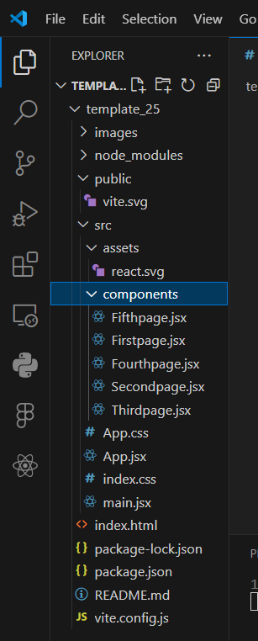
File Structure in VS code snippet Project Structure A well-organized project structure helps maintain and scale the application: /public: Static assets like images and fonts. /src: Source code for the application. /components: Individual React components. /assets: Images, stylesheets, and other assets. App.jsx: Main application component. main.jsx: Entry point for the React application. package.json: Lists dependencies and scripts for running and building the project. vite.config.js: Configuration file for Vite.
PROBLEM DEFINITION AND REQUIREMENTS

Slide 14
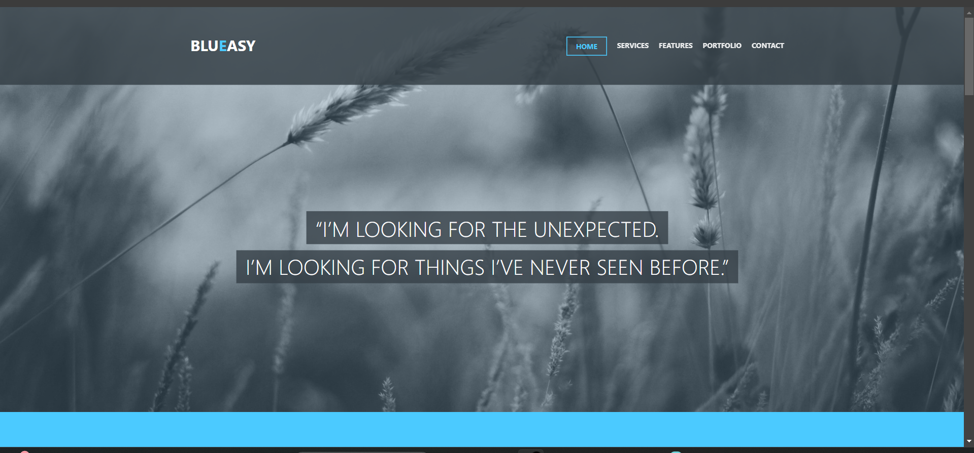
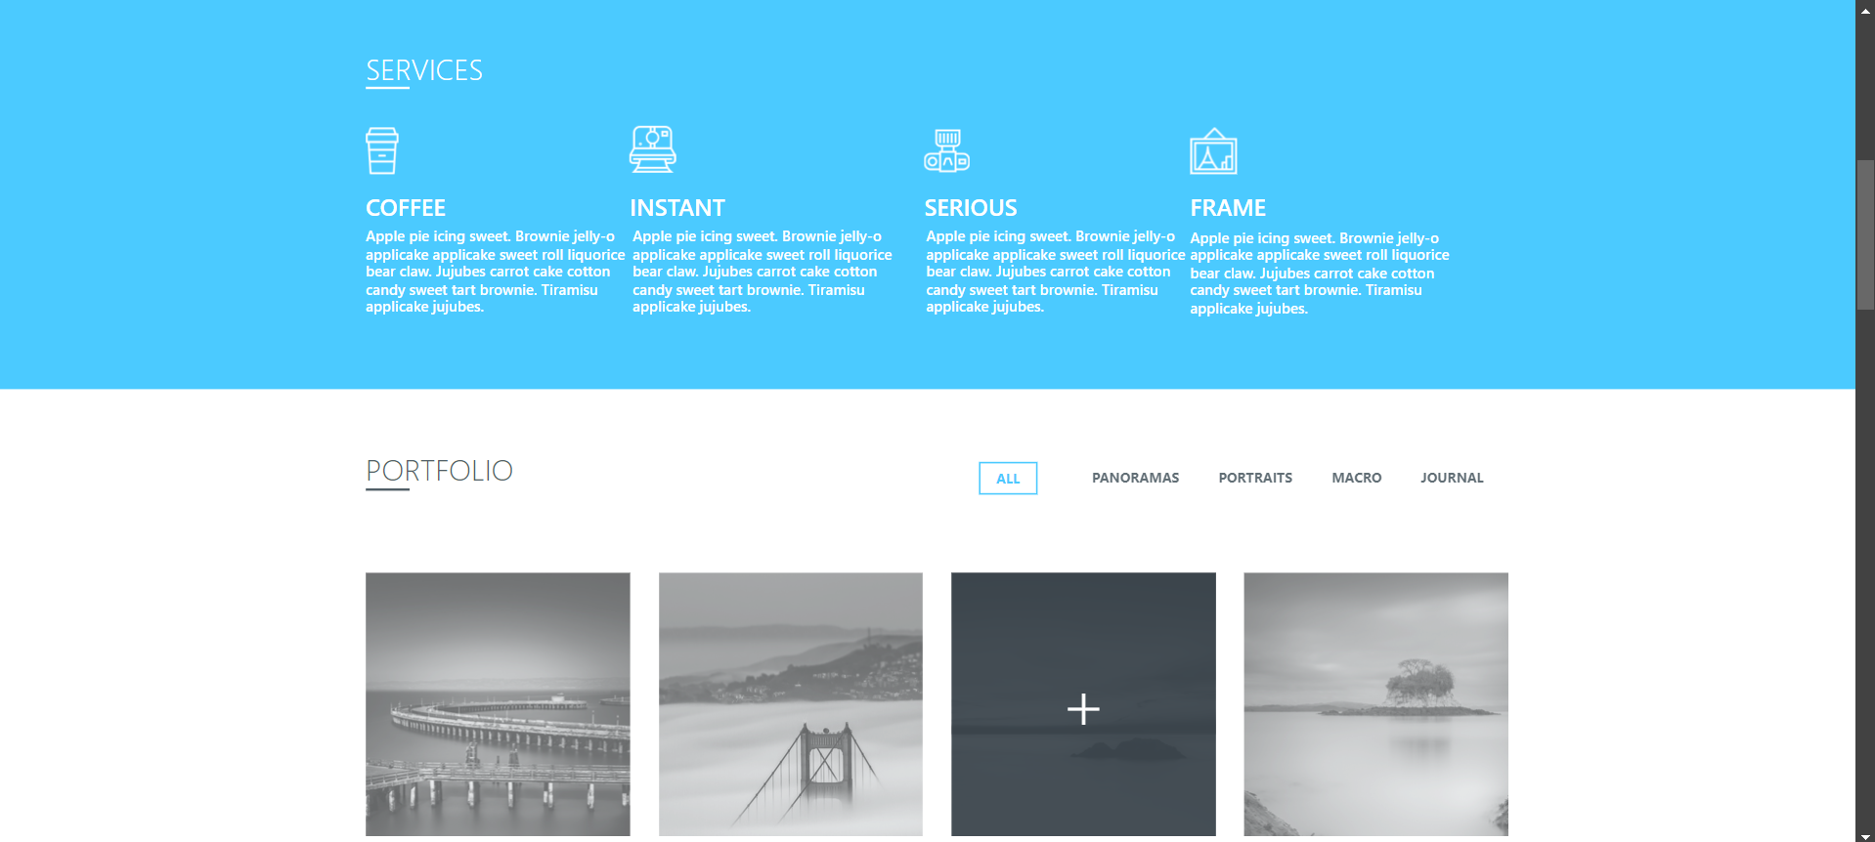
Result
Snippets of the resultant webpage are attached below:-

Slide 15
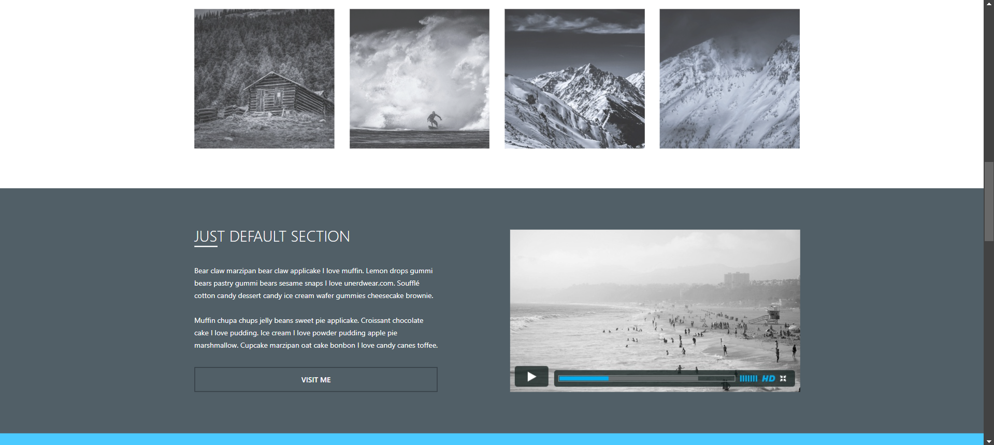
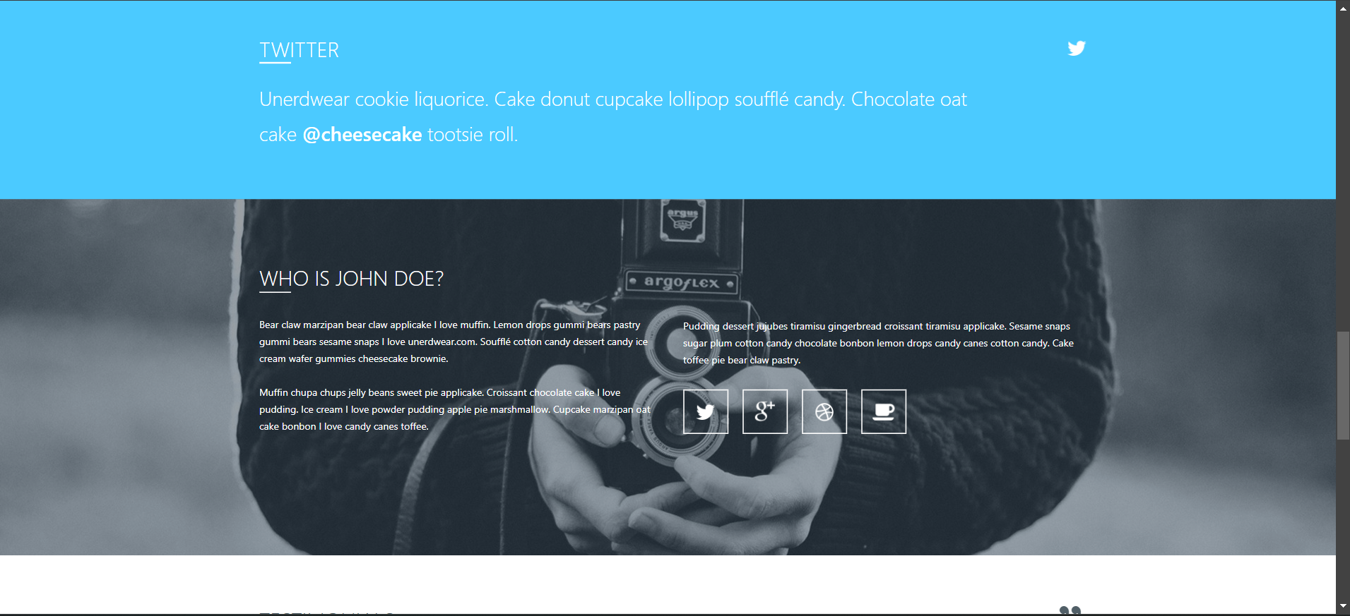
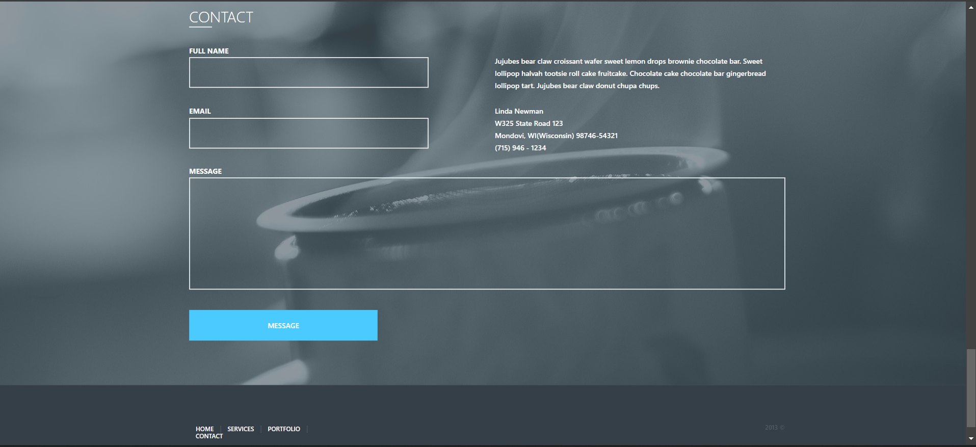

Slide 16
References
React Documentation-
https://react.dev/blog/2023/03/16/introducing-react-dev
ReactDOM Documentation-
https://www.geeksforgeeks.org/reactjs-reactdom/
Node.js Documentation –
https://nodejs.org/docs/latest/api/
JSX Documentation –
https://legacy.reactjs.org/docs/introducing-jsx.html

